Slide 1
How Rocks Get Where They Get
Sedimentary Rocks
Earth Science

Slide 2
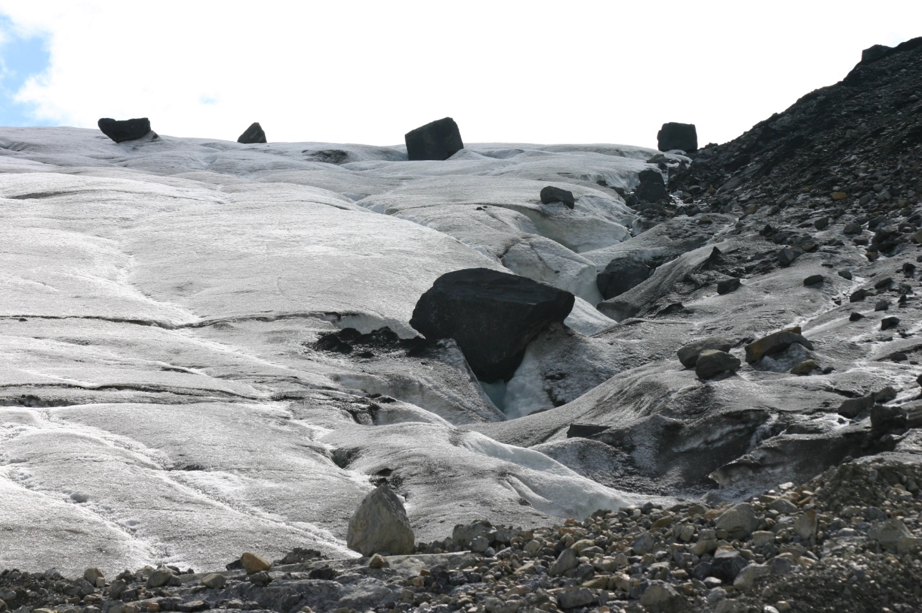
Transportation & Deposition
For Clastic rocks: Clasts (sediments) are physically transported by wind, water, glaciers, and/or gravity.

Slide 3
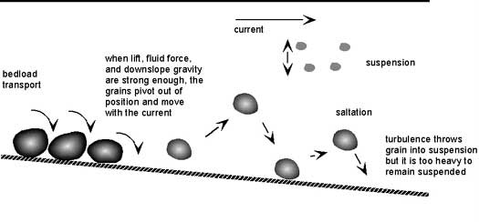
Clasts are deposited when the transportation energy is insufficient to move the particle. As transportation energy decreases, the larger (heavier) particles are deposited first.

Slide 4
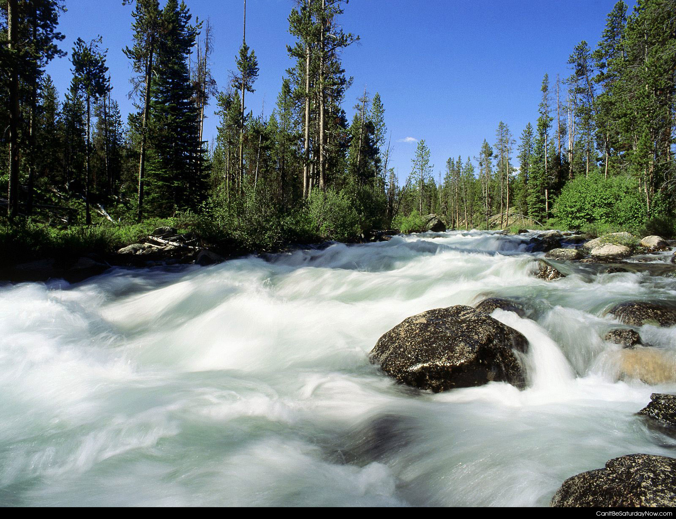
HIGH ENERGY environments can transport large and small particles

Slide 5
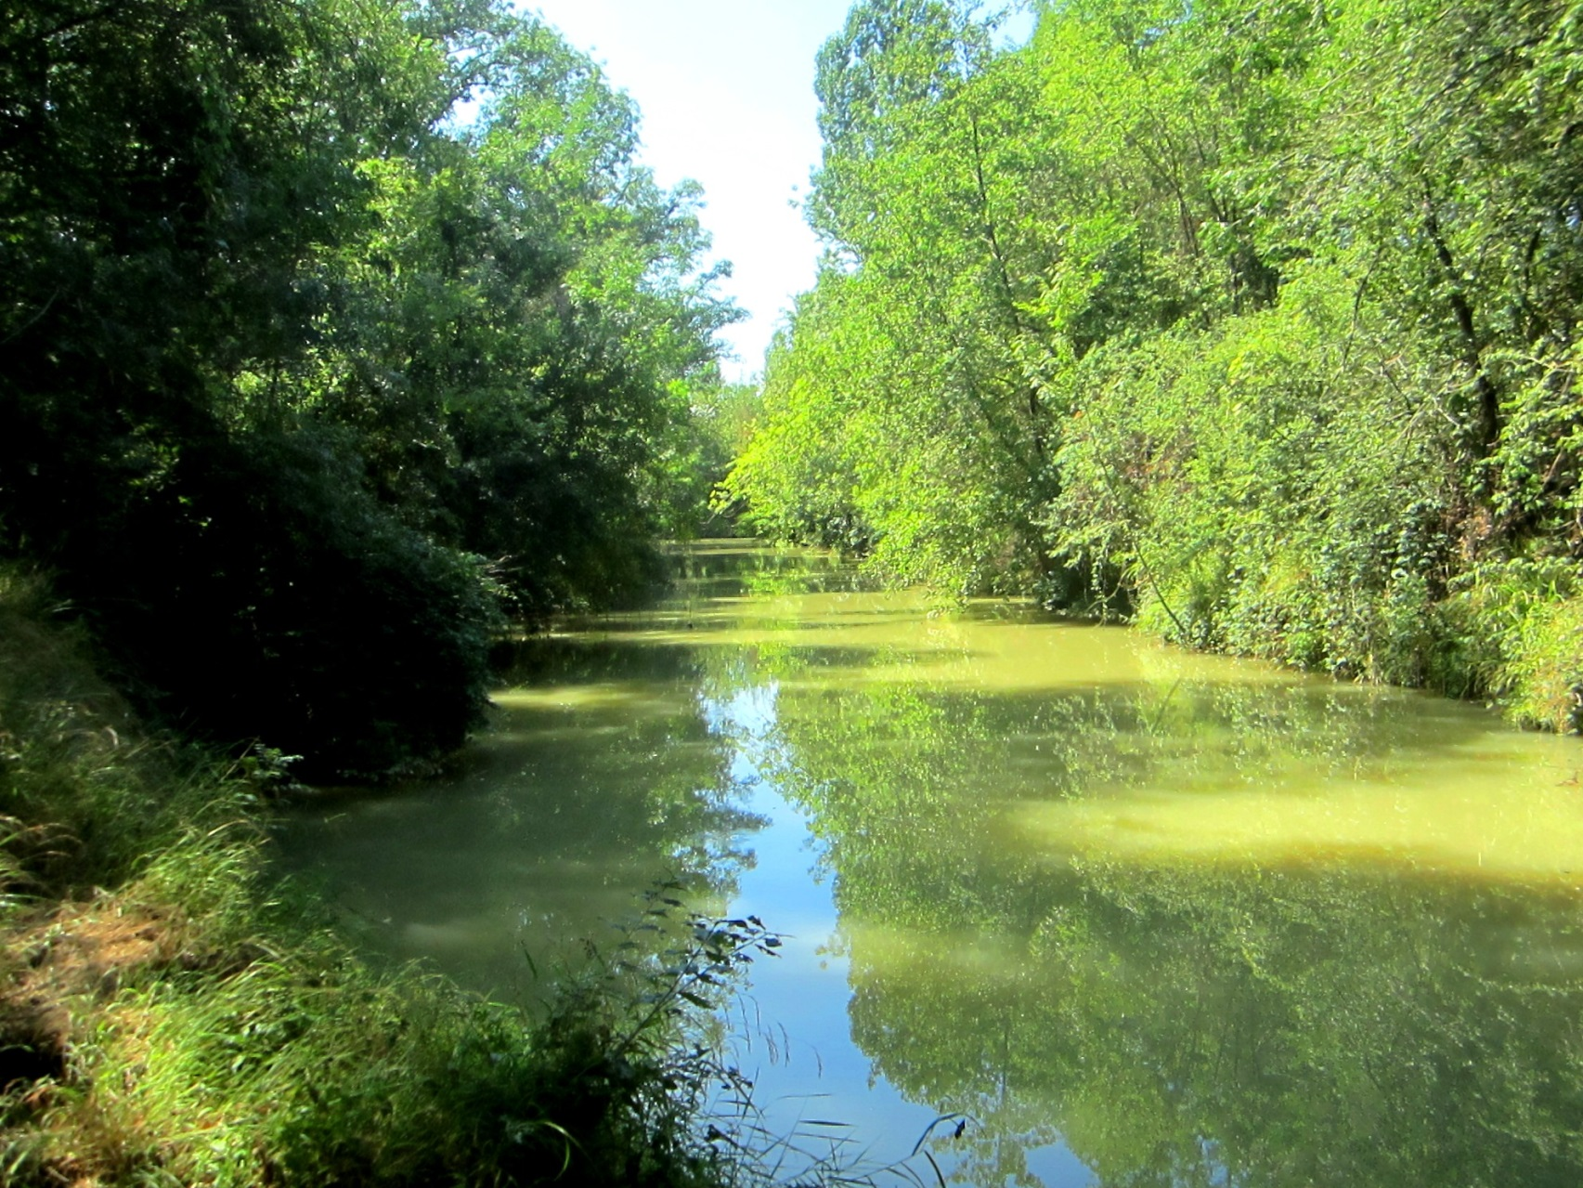
LOW ENERGY environments can transport only small particles

Slide 6
Examples of high and low energy environments?
Low Energy Environment | High Energy Environment
Lagoon | Storm-Dominated Beach
Deep Lake | Steep Mountainside (Landslide)
Deep Ocean | Tornado
 | Tsunami

Slide 7
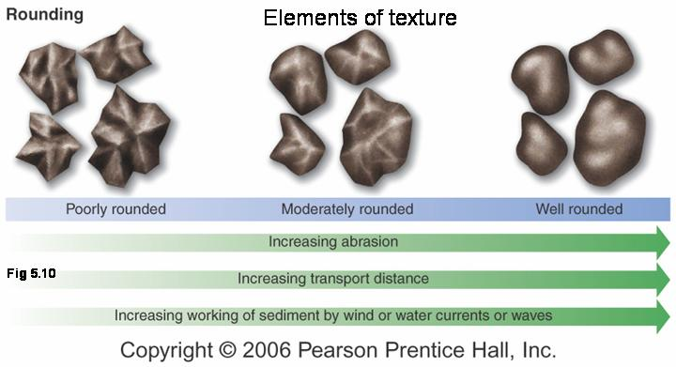
NOTE: The longer the transportation distance, the more exposure the sediment has to chemical and physical weathering, and the rounder and smaller the sediments generally become.

Slide 8
For Chemical rocks: Chemical sediments are generated by the precipitation of minerals out of solution by biological activity, chemical change, or evaporation. These minerals (chemical sediments) are precipitated when the dissolved ion concentration becomes too large to remain in solution.

Slide 9
Where do these dissolved ions come from?
This is an important question since the dissolved ions are the "building blocks" for the chemical sediments. It is the chemical weathering of sediments (dissolution of minerals) that releases these ions into solution. Once in solution, the ions can travel in groundwater, rivers, etc. to their final destination (such as an ocean, lake, cave, etc.) where they are precipitated as minerals.

Slide 10
For Organic Rocks: Remains of plants and animals may fall to the ground or into water, and are then washed downstream, may come to rest at the bottom of a swamp, pond, lake, or ocean, and are then covered over with other sediments. Over time the compaction of the organic materials, along with the decay of the organic materials changes the dead stuff into rock

Slide 11
Texture: (For Clastic Rocks Only)
1) Particle Size:
Clay (Very Fine Grained): < 1/256 mm
Silt (Fine Grained) : 1/256 to 1/16 mm
Sand (Medium Grained) : 1/16 to 2 mm
Pebbles (Coarse Grained) : > 2 mm
Particle size indicates the energy of the transporting medium. The larger the size of grains in a clastic rock, the more energy it took to move that particle to the place of deposition!

Slide 12
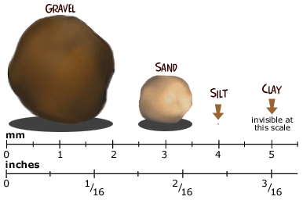

Slide 13
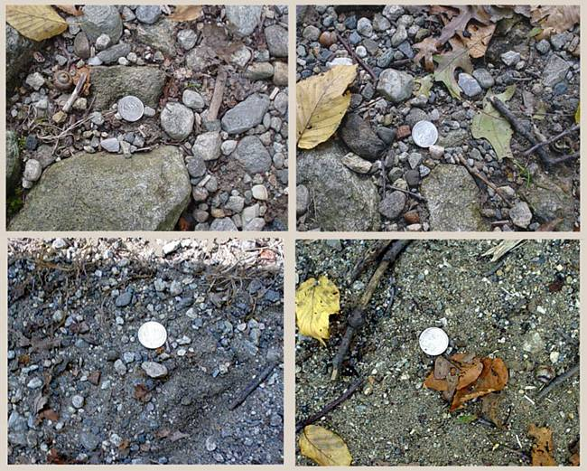
2) Angularity: Degree to which the individual sedimentary particles are rounded.
WELL ROUNDED - all corners of a grain are rounded off

Slide 14
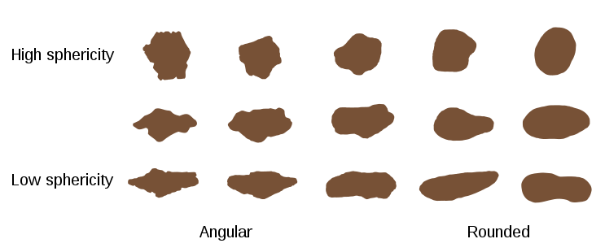
ANGULAR - all corners of a grain are still sharp (pointed)
The more the corners of an individual grain in a clastic rock are rounded, the longer the distance the grain has been transported.

Slide 15
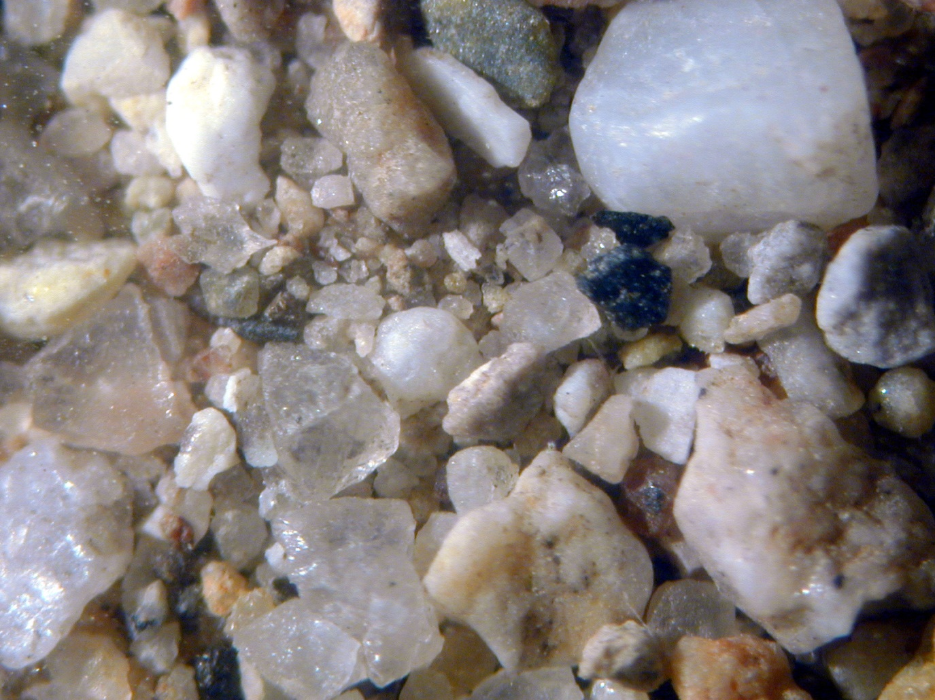
3) Sorting: Degree to which the sedimentary particles are the same size.
POORLY SORTED - large and small grains jumbled together

Slide 16
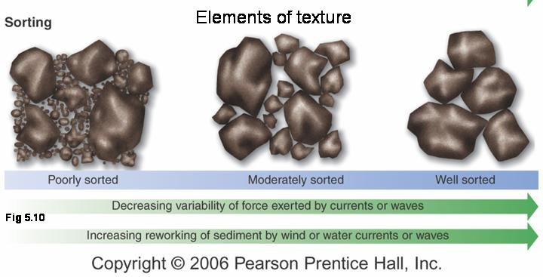
WELL SORTED - all grains are the same size!
Poor sorting suggests that the particles have not been transported very far.

Slide 17
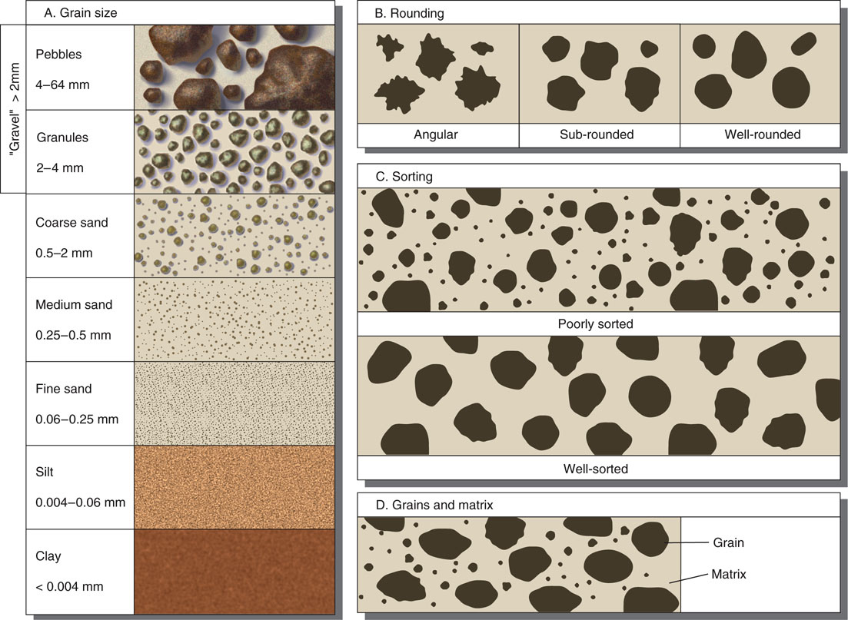

Slide 18
Clastic Rocks: Let's pull all of this together!
What would be some general trends seen if you were to look at the sediments being weathered, eroded, and transported from a granite mountain to the plains to a deep lake or ocean?

Slide 19
General trends: Distance from sediment source vs. texture and mineralogy
 | At source | Near source | Intermediate from source | Far from source | Farthest from source
Largest grain size seen | boulder-sized | pebble to sand | sand | silt | clay-sized
Angularity | angular | sub-rounded | rounded | well rounded
Sorting | poor | poor to moderate | moderate to well | well | well
Typical clastic rock | breccia | conglomerate, arkose | quartz sandstone | siltstone | shale

Slide 20
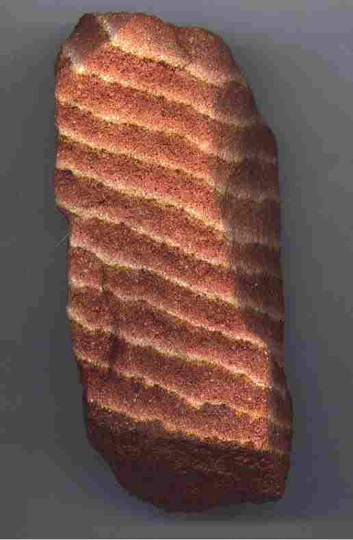
Sedimentary Structures and Fossils--things found in sedimentary rocks
Stratification - horizontal layering at time of deposition

Slide 21
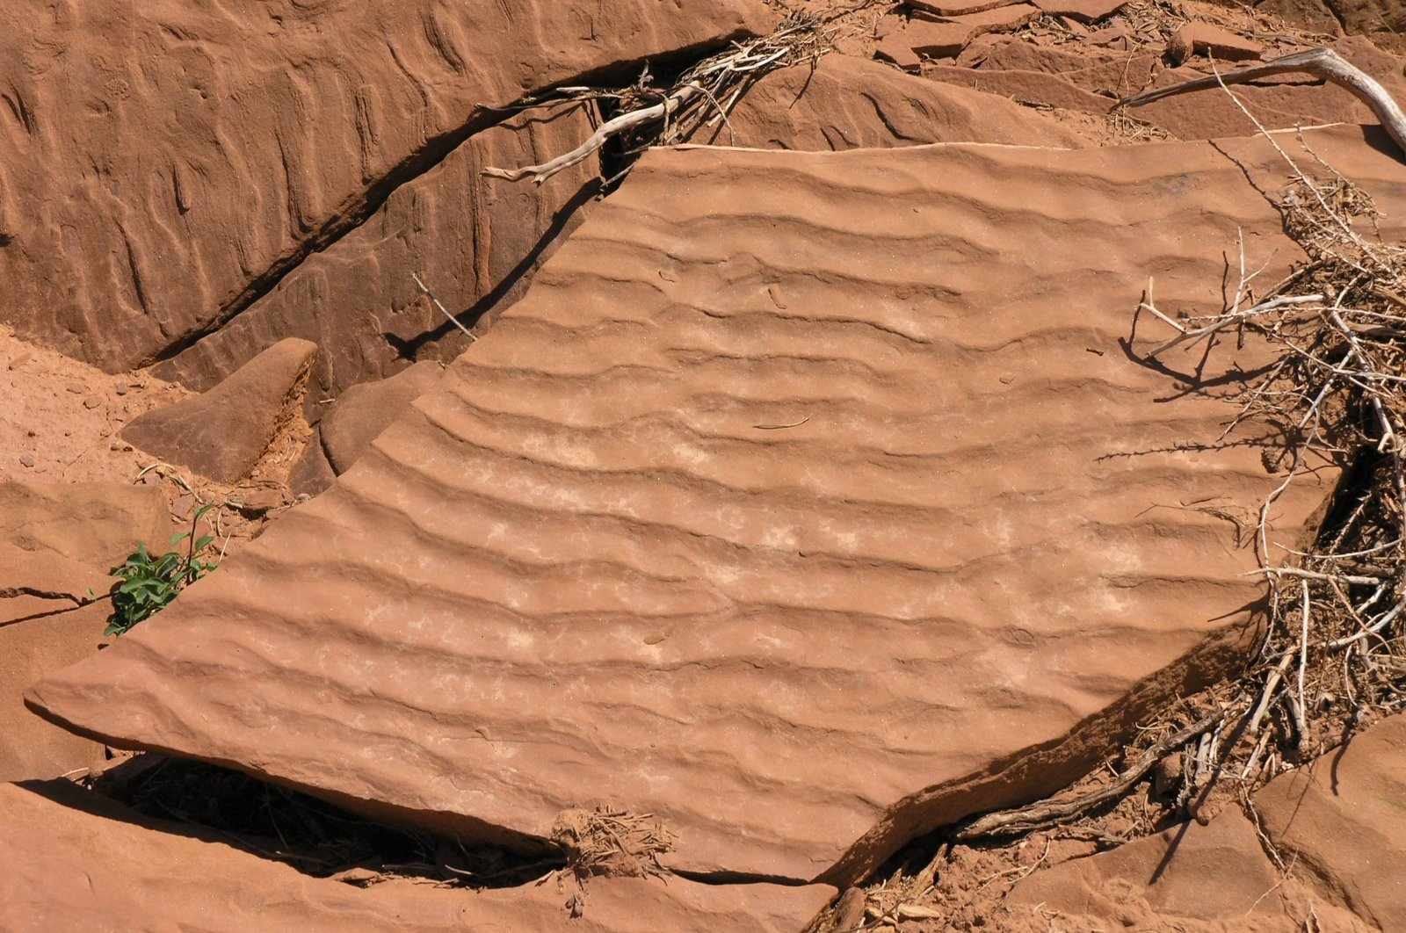
Ripple Marks - undulatory structures due to wind/water current

Slide 22
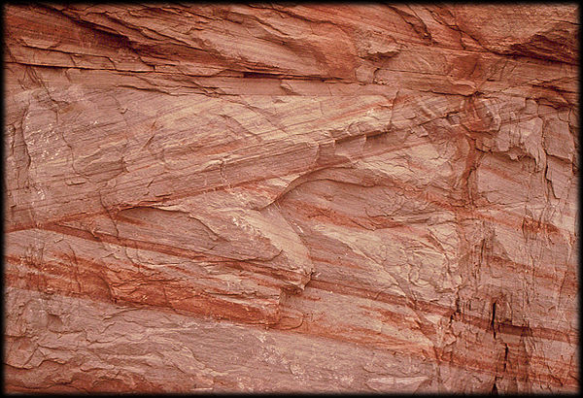
Cross Bedding - internal angular layering within a horizontal bed (due to ripple mark remnants)

Slide 23
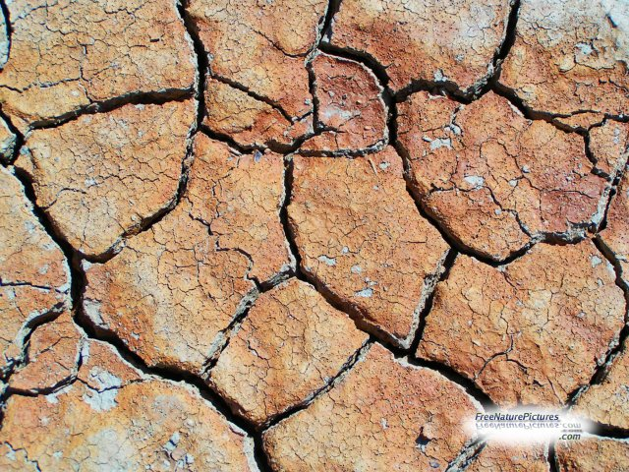
Mud Cracks (Desiccation Cracks) - when mud (basically clay) dries, it shrinks and pulls apart from itself--forming polygonal columns.

Slide 24
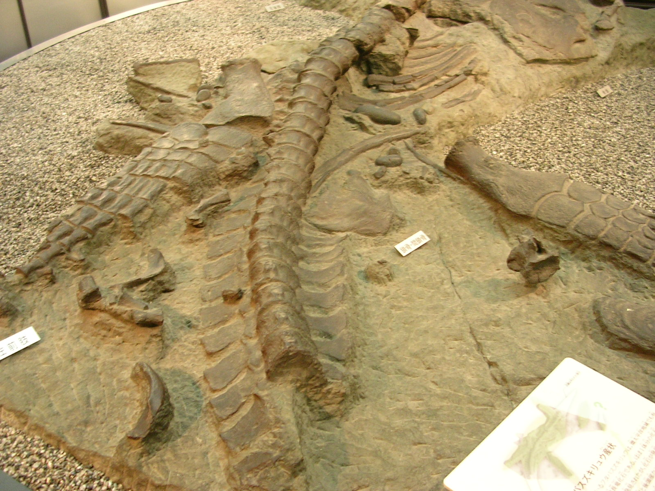
Fossils - evidence of past life (either a remnant of the organism itself or its activity); can indicate where the sediments were deposited

Slide 25
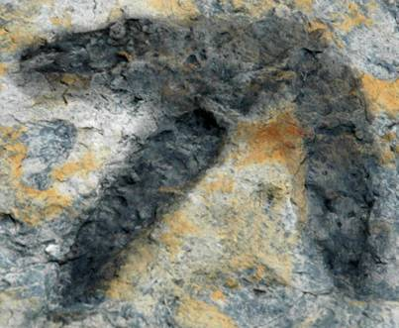
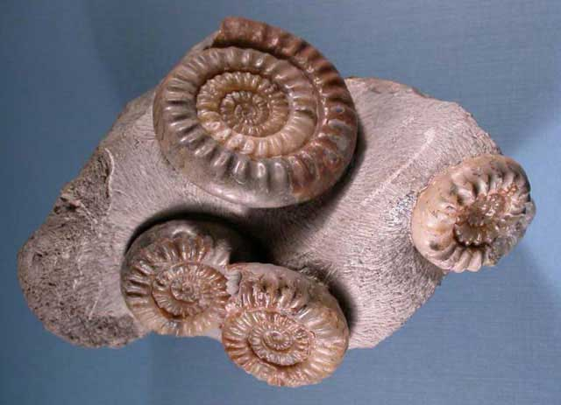
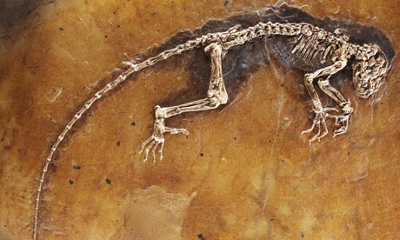
→ Fossils may include (but are not limited to):
- Bones and / or bone fragments
- Shells and / or shell impressions
- Foot / paw prints or tracks of any kind

Slide 26
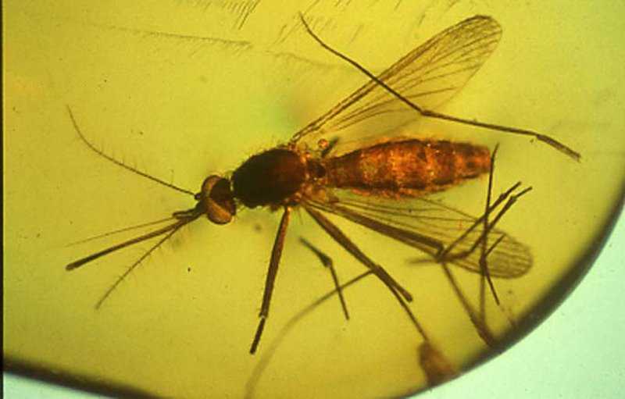
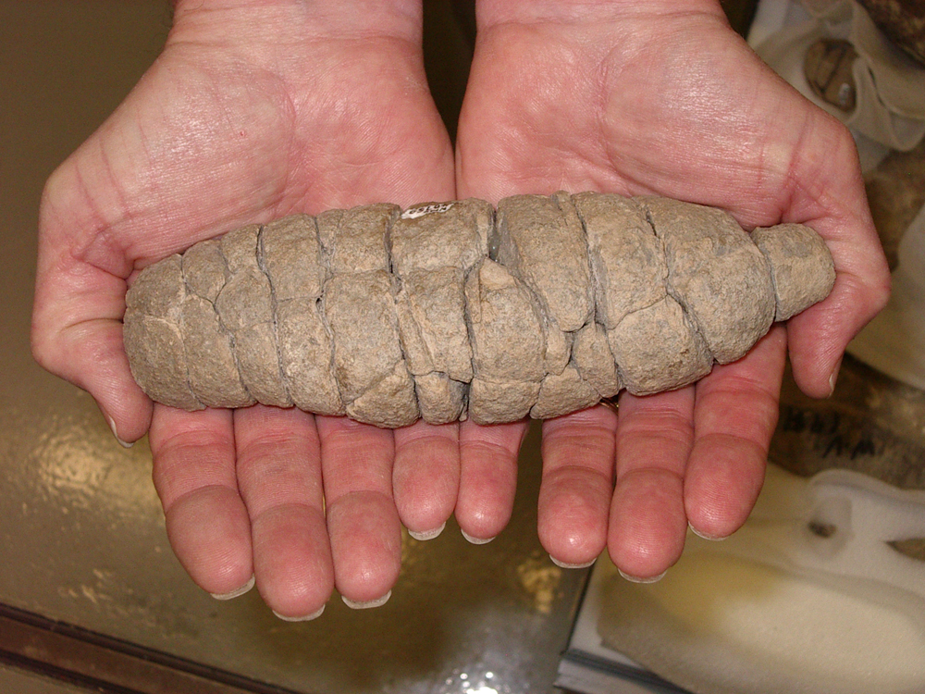
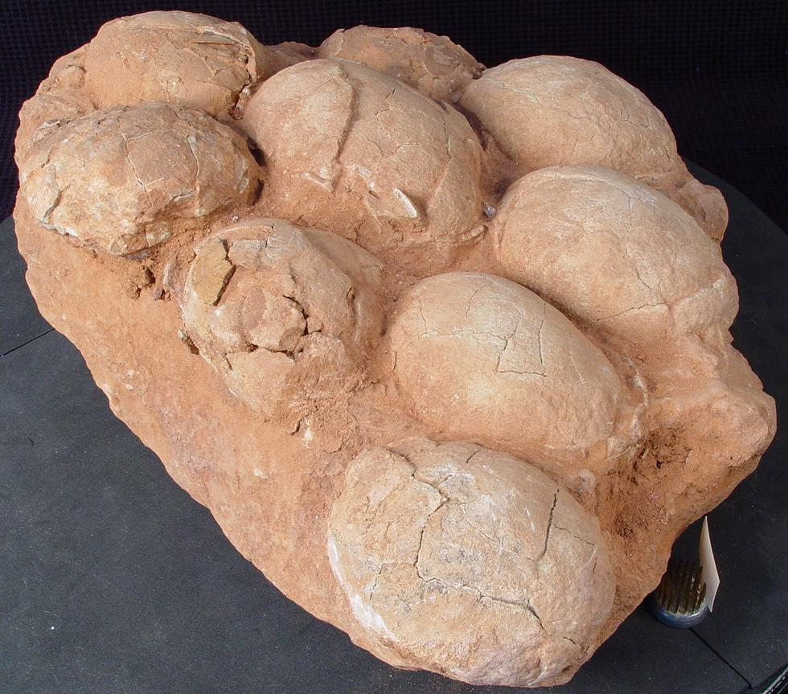
- Waste materials (droppings)
- Preserved materials (such as mosquitos in
fossilized amber)
- Nesting remains

